Slide 1
1. Estimating Project Times and Costs, Ch. 5-T1… 2. Managing Risk, Ch. 7, T1
M K Hamirwasia
WILPD

Slide 2
AE/DE/MM/ES/POM ZG523-Merged
Project Management
Lecture No. 15

Slide 3
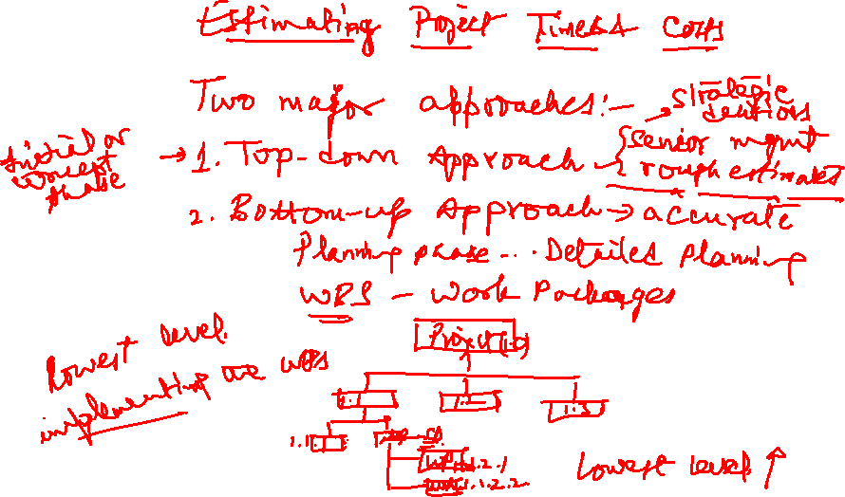

Slide 4

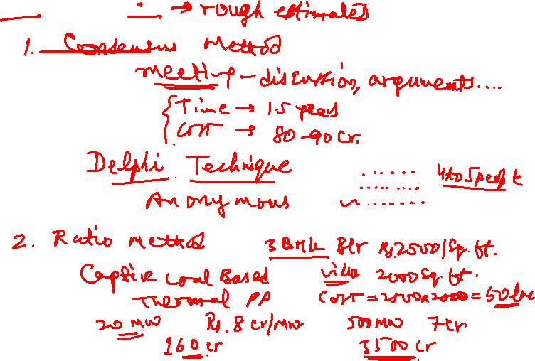

Slide 5
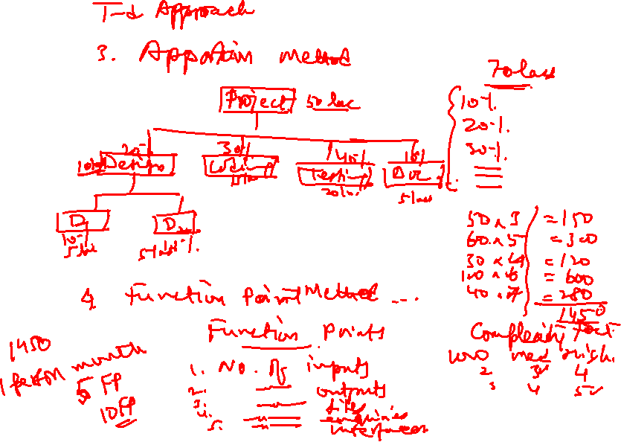

Slide 6


Slide 7
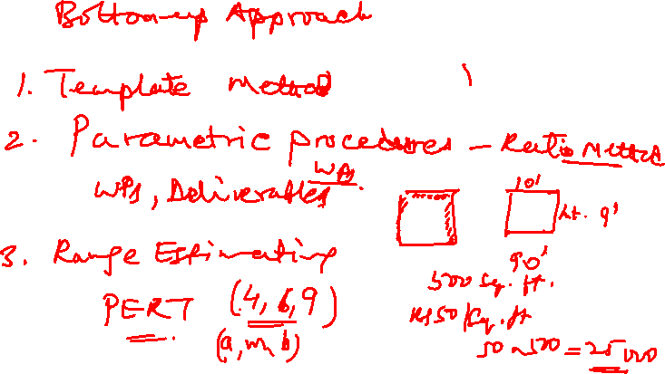

Slide 8
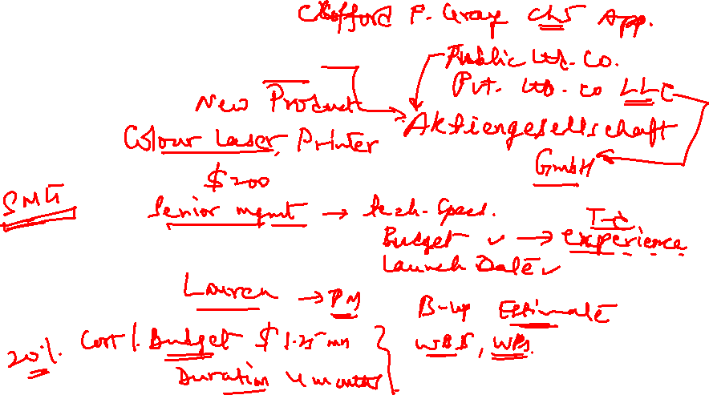
CASE 5.1
Sharp Printing, AG

Slide 9
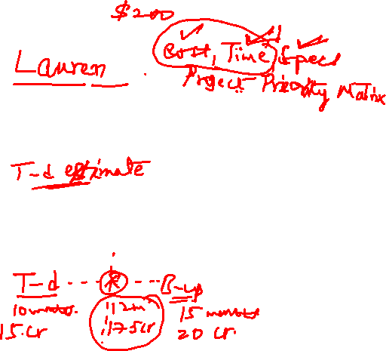
CASE 5.1
Sharp Printing, AG
At this point, what would you do if you were the project manager?
2. Was top management acting correctly in developing an estimate?
3. What estimating techniques should be used for a mission critical project such as this?

Slide 10
Lecture 15
Managing Project Risk, Ch. 7, T1

Slide 11
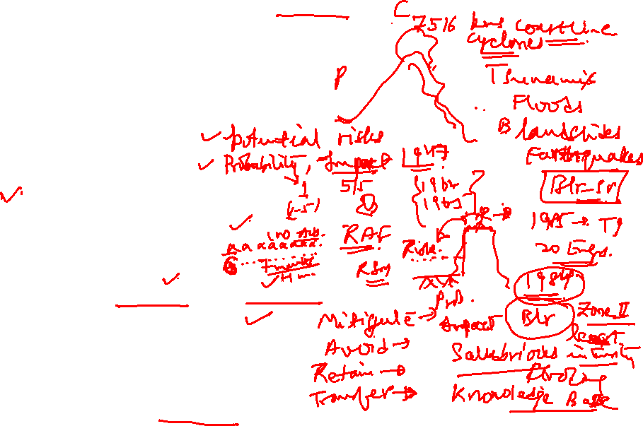
Managing Project Risk
Introduction to the Topic
Risk Management Process
Risk Identification
2. Risk Assessment
Risk Response Development
* Contingency Planning
* Handling Risks
* Contingency Funding and Time Buffers
Risk Response Control
* Change Control Management
Case 7.1 Discussion

Slide 12
Introduction
What is Risk?
Project Risk is defined by PMI as 'an uncertain event or condition that, if it occurs, has a positive or negative effect on a project’s objectives'.
Anything that might occur to change the outcome of a project activity, we call that a risk.
A risk can be an event (like an earthquake) or it can be a condition (like an important part being unavailable).

Slide 13
Introduction
A risk has a cause, and if it occurs, a consequence.
Cause:
Fatal accident at the site – the work is held up for a day
Change in scope – the product has to be redesigned
Consequences: The schedule and cost of the project will be adversely affected.

Slide 14
Introduction
Even the most carefully planned project can run into trouble.
No matter how well you plan, your project can always encounter unexpected problems.
Team members get sick or quit, resources that you were depending on turn out to be unavailable, even the weather can throw you for a loop (e.g., a windstorm).
So does that mean that you’re helpless against unknown problems? No! You can use risk planning to identify potential problems that could cause trouble for your project, analyze how likely they are to occur, take action to prevent the risks you can avoid, and minimize the ones that you can’t.

Slide 15
Introduction
What is Project Risk Management?
Project Risk Management is the identification, assessment, and prioritization of risks followed by coordinated and economical application of resources to minimize, monitor, and control the probability and/or impact of unfortunate events or to maximize the realization of opportunities.
Project risk management attempts to identify and manage potential and unforeseen trouble spots that may occur during project implementation.
Good Project Risk Management depends on supporting organizational factors, clear roles and responsibilities, and technical analysis skills.

Slide 16
RISK MANAGEMENT PROCESS
Project risk management in its entirety,
includes the following six process groups:
Planning risk management
Risk identification
Performing qualitative risk analysis
Performing quantitative risk analysis
Planning risk responses
Monitoring and controlling risks

Slide 17
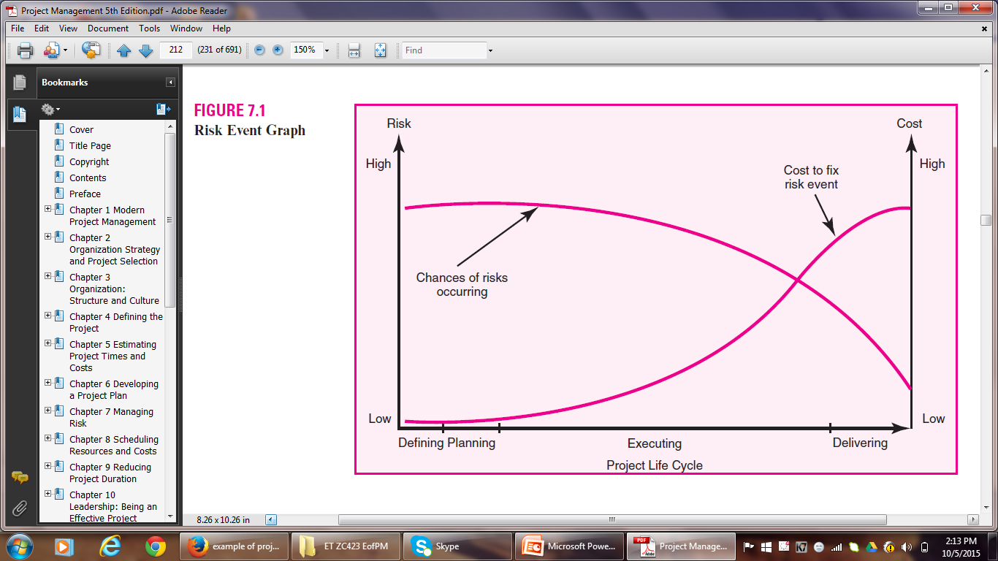
RISK MANAGEMENT PROCESS

Slide 18
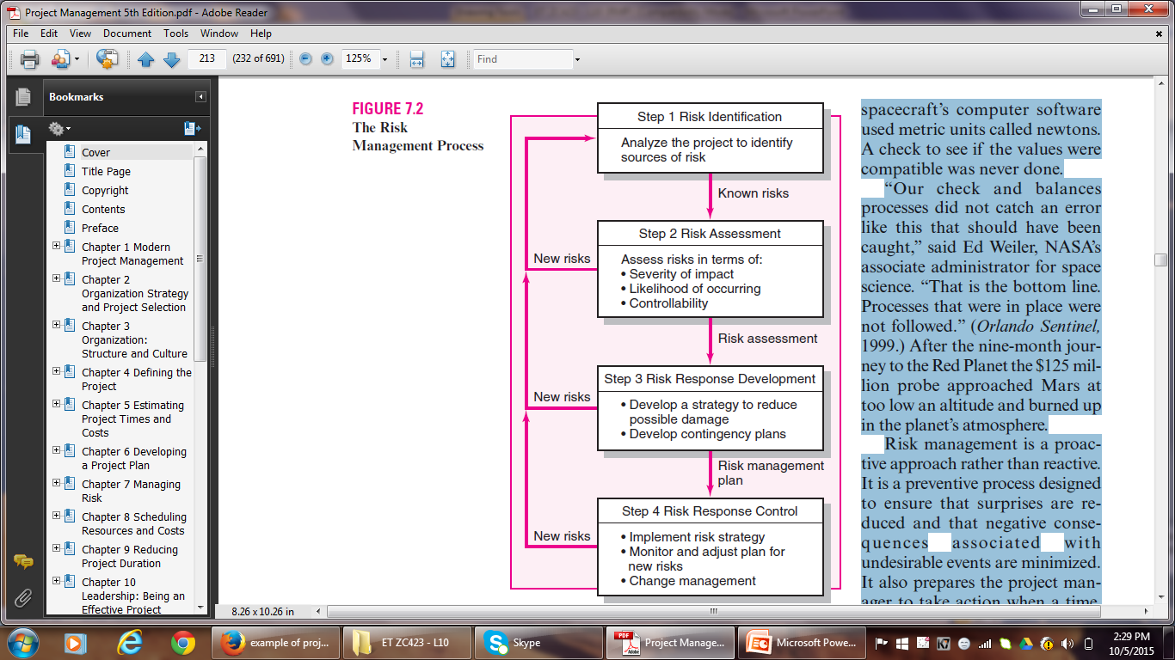
RISK MANAGEMENT PROCESS

Slide 19
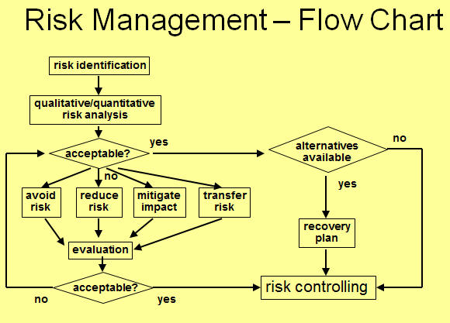
RISK MANAGEMENT PROCESS

Slide 20
RISK MANAGEMENT PROCESS
Major components of the Risk Management Process:
1. Risk Identification
2. Risk Assessment
3. Risk Response Development
4. Risk Response Control

Slide 21
Risk Identification
Risk Identification
Put in place a “risk management team” consisting of core project team members and other stakeholders.
Research has demonstrated that groups make more accurate judgments about risks than individuals do.
Brainstorm to identify potential risks.
Generate a list of potential risks.
Caution Note – Focus on actual events that could cause problems, not on the objectives.

Slide 22
Risk Identification
Important tools used to identify risks are:
Risk Breakdown Structure
Risk Profile

Slide 23
Risk Breakdown Structure
RBS lists the categories and subcategories within which risks may arise from a typical project.
Macro risks – risks that can affect the whole project
Eg.
Funding – possibility of budget being cut after the project has started
Market – new product releases by competitors
Micro risks – risks that can affect a specific section of the project or network

Slide 24
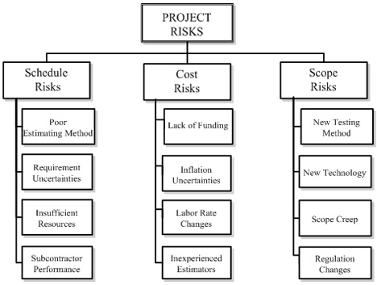
Risk Breakdown Structure

Slide 25
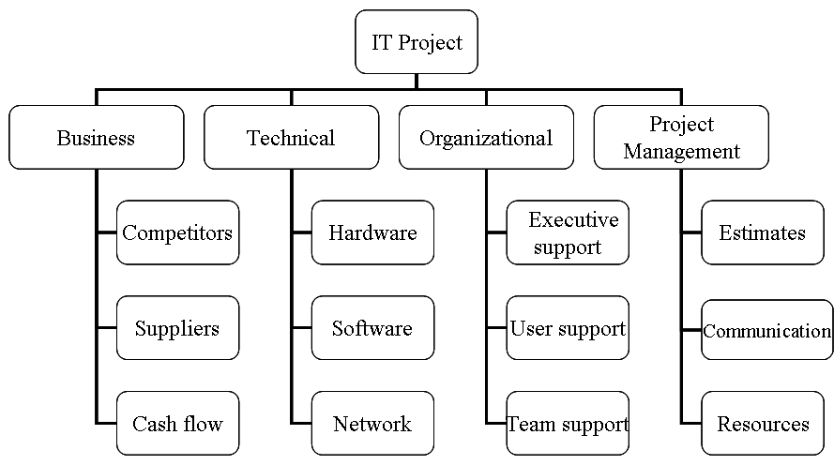
Risk Breakdown Structure

Slide 26
Risk Profile
A Risk Profile is a list of questions that address traditional areas of uncertainty on a project.
These questions have been developed and refined from previous, similar projects.
Risk profiles address both technical and management risks.
Risk profiles are generated and maintained by project office personnel.
During the post-project audit, they are updated.

Slide 27
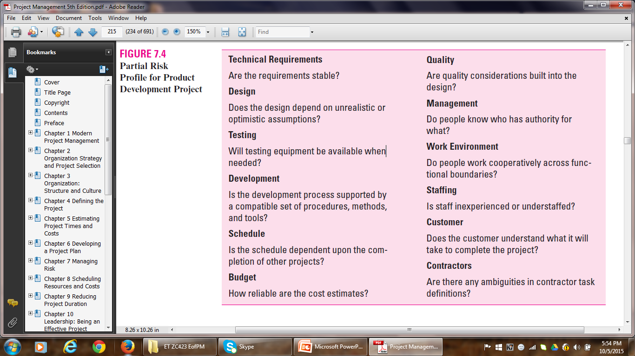
Risk Profile

Slide 28
Risk Assessment
2. Risk Assessment
Once all possible risks have been identified and the list is ready:
Sift through the list of risks.
Eliminate inconsequential or redundant risks.
Stratify worthy risks in terms of importance and need for attention.

Slide 29
Risk Assessment
Most commonly used technique for analyzing risks:
Scenario Analysis
is the assessment of the significance of each risk event in terms of:
Probability (likelihood) of the event occurring.
Impact of the event.
Eg.
Lightning
Employee turnover

Slide 30
Risk Assessment
Probabilities and impacts need to be defined in terms of either rank-order descriptors or numeric weights.
Likelihood scales:
Very Unlikely – Unlikely – Likely – Highly Likely – Almost Certainly
1 2 3 4 5
Impact scales:
Very Low – Low – Moderate – High – Very High
1 2 3 4 5
Risk Assessment Forms are used to capture scenario analyses.

Slide 31
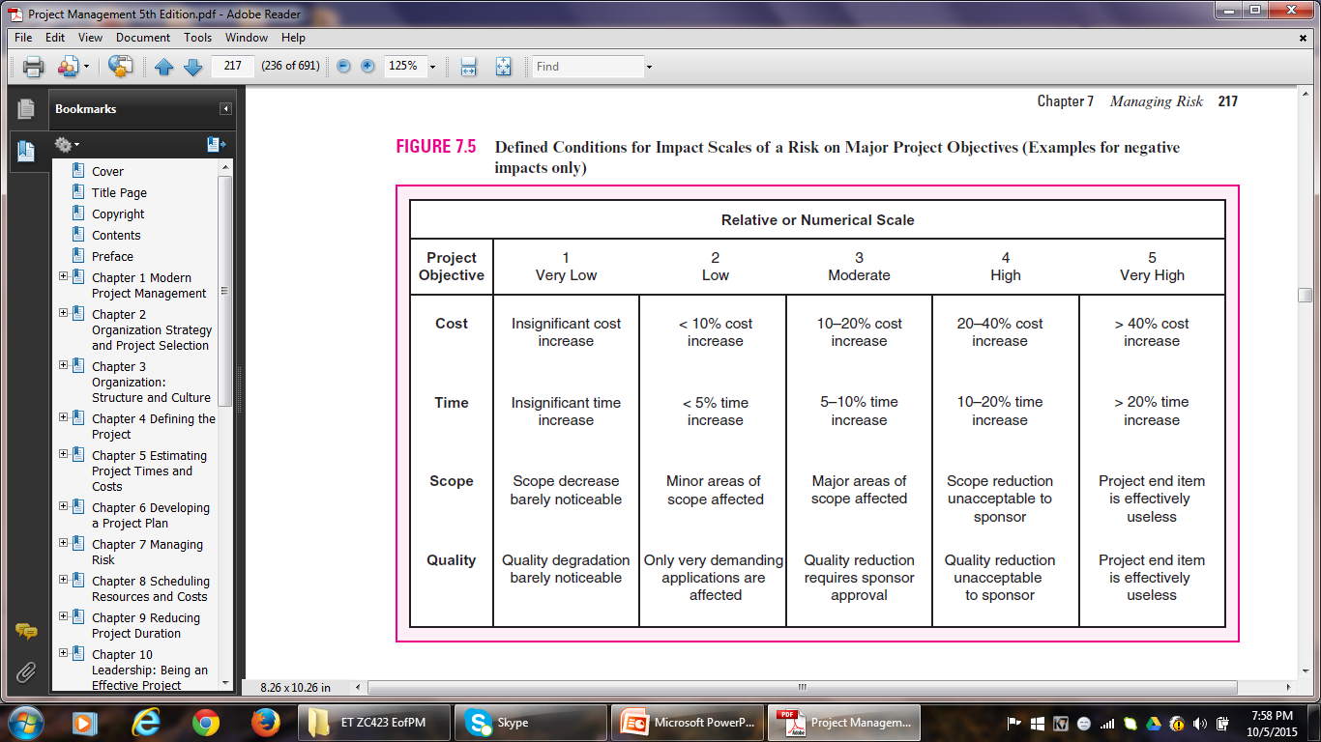
Risk Assessment

Slide 32
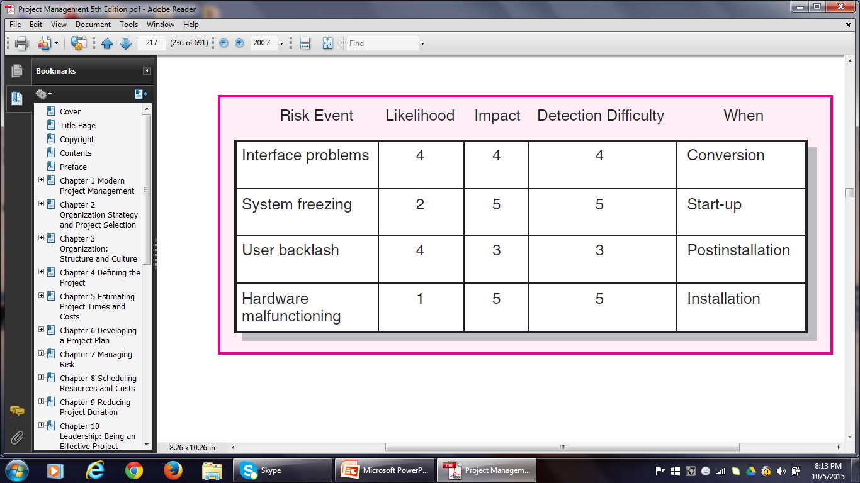
Risk Assessment Form

Slide 33
Risk Severity Matrix
The severity of different risks can be categorized into the form of Risk Assessment Matrix.
The matrix is structured around the impact and likelihood of the risk event.
The matrix is divided into Red, Yellow and Green zones.
Red zone – major risks (high impact / high likelihood)
Yellow zone – moderate risks
Green zone – minor risks (low impact / low likelihood)
The Risk Severity Matrix provides a basis for prioritization of risks.
Red zone – first priority Green zone – ignored
Yellow zone – second priority

Slide 34
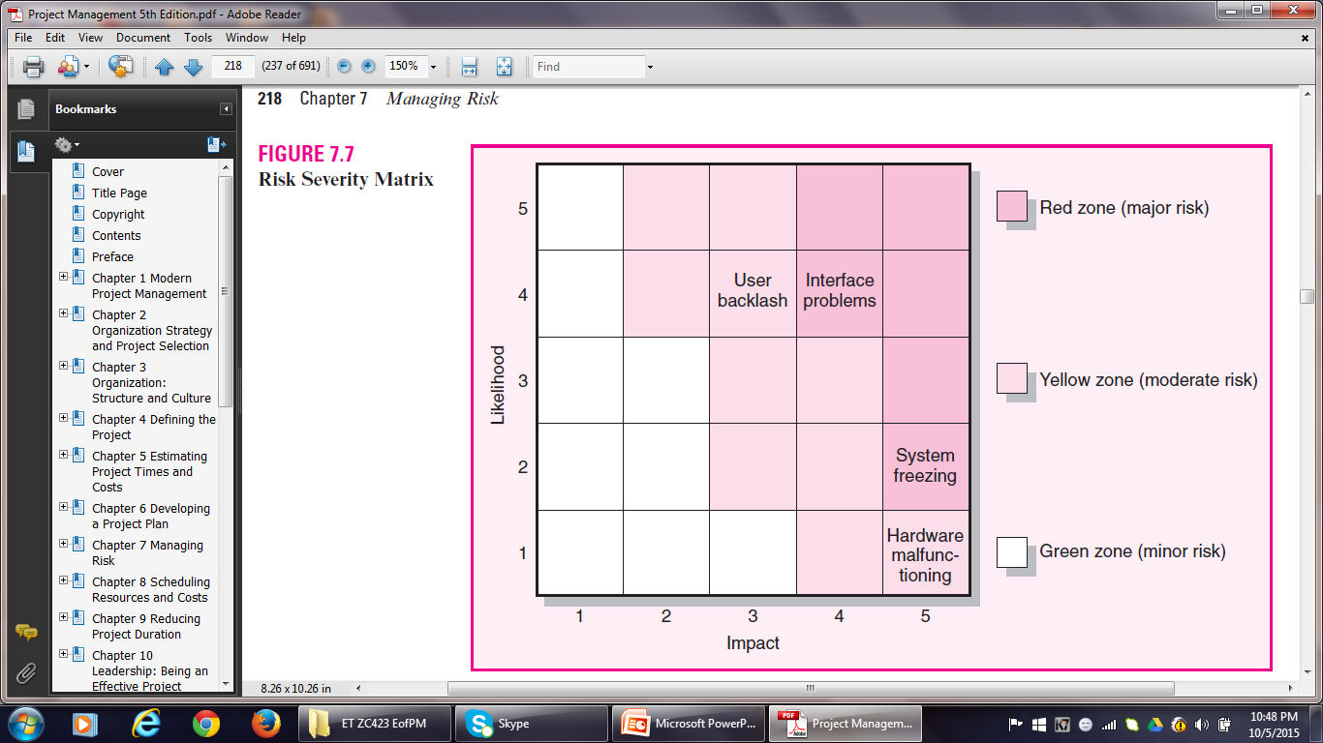
Risk Severity Matrix

Slide 35
FMEA
Failure Mode and Effects Analysis extends the risk severity matrix by including ease of detection of risk in the equation:
Impact × Probability × Detection = Risk Value
Detection is the ability of the project team to perceive that the risk event is about to happen.
Each of the three dimensions is rated according to a five-point scale.
A score of 1 would be given if even a chimpanzee could spot the risk coming.
A score of 5 would be given to events that could only be discovered after it is too late.

Slide 36
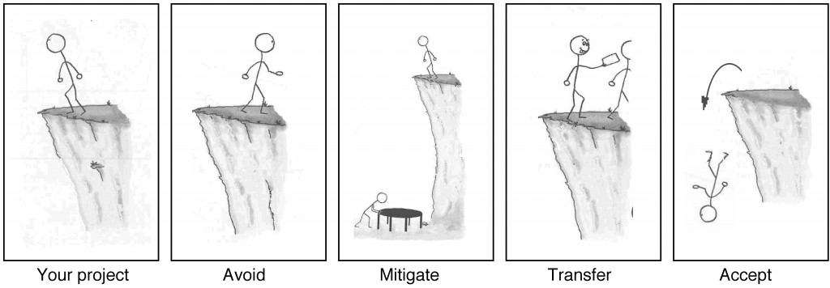
Risk Response Development
3. Risk Response Development
Risk Management Options

Slide 37
Risk Response Development
If your project requires that you work on the edge of a cliff, then there’s a risk that you could fall. If it’s very windy out or if the ground is slippery and uneven, then falling is more likely.
There are four basic ways to handle a risk.
Avoid: The best thing you can do with a risk is avoid it. If you can prevent it from happening, it definitely won’t hurt your project. The easiest way to avoid this risk is to walk away from the cliff, but that may not be an option on this project.
Mitigate: If you can’t avoid the risk, you can reduce it. This means taking some sort of action that will cause it to do as little damage to your project as possible.

Slide 38
Risk Response Development
Transfer: One effective way to deal with a risk is to pay someone else to accept it for you. The most common way to do this is to buy insurance.
Accept: When you can’t avoid, mitigate, or transfer a risk, then you have to accept it. But even when you accept a risk, at least you’ve looked at the alternatives and you know what will happen if it occurs. If you can’t avoid the risk, and there’s nothing you can do to reduce its impact, then accepting it is your only choice.

Slide 39
Risk Response Development
Mitigating Risk
Usually the first option considered.
Two strategies for mitigating risk:
Reduce the likelihood that the event will occur and/or
Reduce the impact of the event on the project
Testing and prototyping are readily used in IS projects to prevent problems from surfacing later in a project.
Some other mitigation measures:
Foreseeable problem – Measure
Vendor may not supply customized components on time – Invite the vendor to design meetings and include contract incentives for on-time delivery.
Duration and costs have been underestimated – Augment estimates to compensate for the uncertainties

Slide 40
Risk Response Development
Avoiding Risk
Technical Failure (Product Development) – Adopt proven technology instead of experimental technology
Politically unstable environment (Supply of Construction Material) – Choose an Indian supplier as opposed to a Pakistani supplier for the supply of critical materials
Likelihood of Rain (Concert) – Organize indoors
Transferring Risk
To Contractor – fixed-price contracts
Insurance – acts of God
BOOT – large international construction projects like oil refineries

Slide 41
Risk Response Development
Retaining Risk
Accept the risk
Sometimes the risk is too large to be transferred or mitigated e.g. flood
However, chances of such risks are slim
The risk is covered by developing a contingency plan to implement if the risk materializes

Slide 42
Risk Response Development
CONTINGENCY PLANNING
A contingency plan is a backup strategy that will be used if a possible foreseen risk event becomes a reality.
Risk Response – preventive in nature
Contingency Plan – reactive in nature
Contingency planning evaluates alternative work-around plans for possible foreseen events before the risk event occurs.
A project may fail in the absence of a CP, lest the undesirable event should take place.
A CP should include a cost estimate and identify the source of funding.
All CPs should be communicated to team members in advance.

Slide 43
Risk Response Development
Risk Response Matrix
RRMs are useful for summarizing how the project team plans to manage risks that have been identified.
Step 1: Identify the Response – whether to reduce, share, transfer or accept the risk.
Step 2: Identify CPs in case the risk still exists.
Step 3: Figure out what would Trigger implementation of the CP.
Step 4: Finally, assign the person who would have Responsibility for initiating the CP.

Slide 44
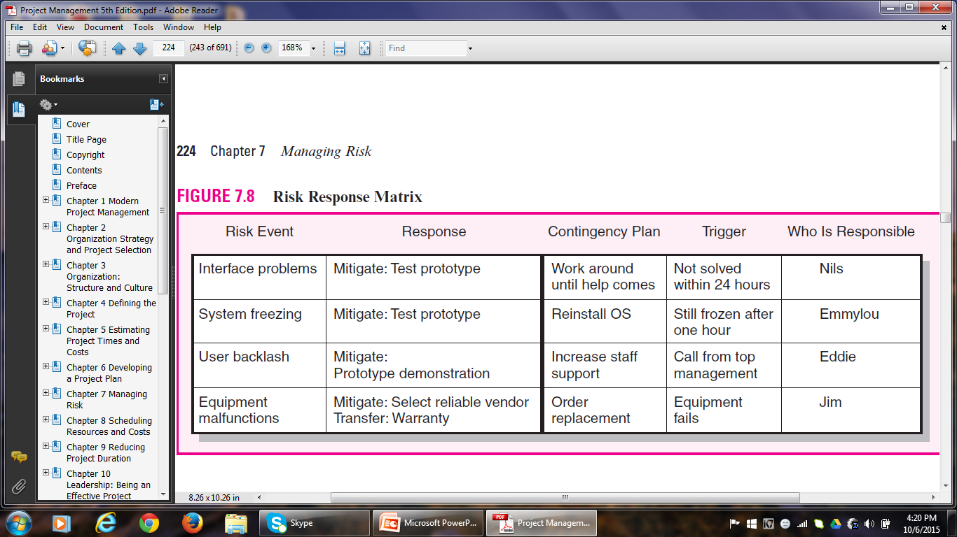
Risk Response Matrix

Slide 45
Risk Response Development
Some common methods for handling risks:
Technical Risks:
Identify the high-risk technical areas
Build models (prototypes) to test their working
Carry out testing (code is working or not!)
Design experiments
Schedule Risks:
Crash the project to get it back on track

Slide 46
Risk Response Development
Cost Risks:
Adjust for inflation, but on an item by item basis, not lump sum
Funding Risks:
Publicly funded projects are more liable to funding risks, owing to change in strategy or political changes.
Private business firms are also susceptible to funding risks owing to change in top management or priorities.
Scale back the scope of the project to the extent possible.

Slide 47
CONTINGENCY FUNDING AND TIME BUFFERS
Contingency funds are established to absorb unplanned costs – identified and unknown.
For control purposes, contingency reserve is divided into budget and management reserve funds.
Budget reserves are set up to cover identified risks.
Budget reserves are allocated to specific activities.
Management reserves are set up to cover unidentified risks.
Management reserves are allocated to risks associated with the total project.

Slide 48
CONTINGENCY FUNDING AND TIME BUFFERS
Budget Reserves
Budget reserves are earmarked for specific segments or activities of a project.
Distributing budget reserves is the responsibility of both the PM and the team members responsible for implementing the specific task.
If the risk does not materialize, the funds are removed from the budget reserve.
Budget reserves decrease as the project progresses.

Slide 49

CONTINGENCY FUNDING AND TIME BUFFERS
Management Reserves
Cover major unforeseen risks.
Applied to the total project.
Controlled by the PM and project owner.
E.g. Scope change
Technical contingencies are also placed in management reserve and controlled by the owner or top management.

Slide 50
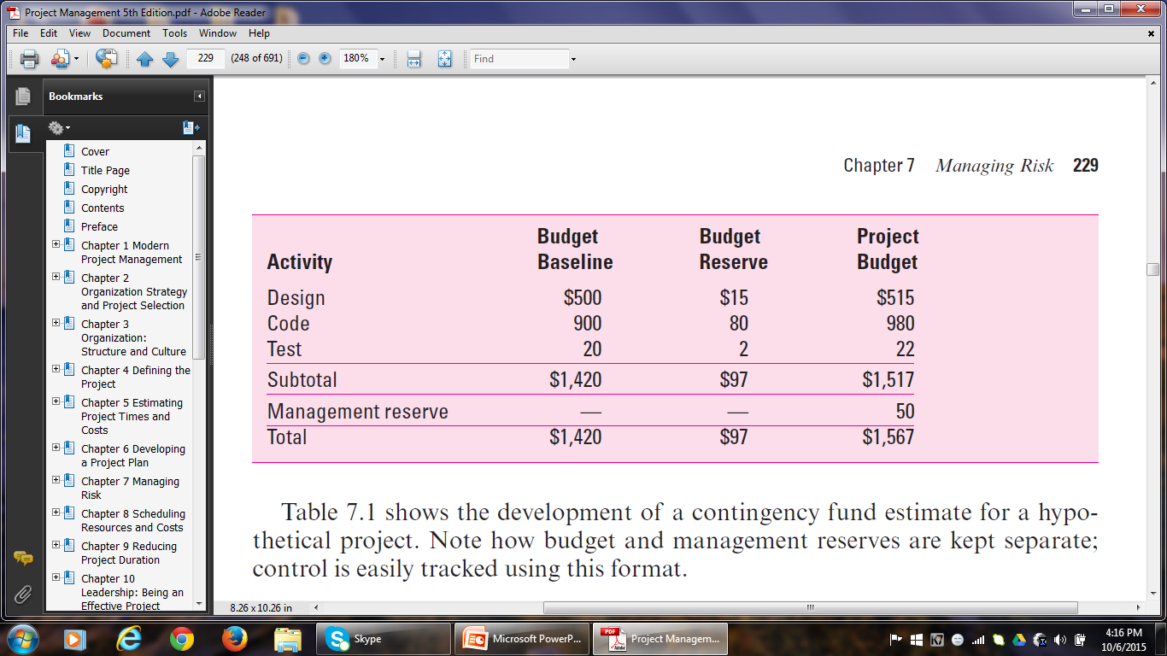
Contingency Fund Estimate

Slide 51
CONTINGENCY FUNDING AND TIME BUFFERS
Time Buffers
Time buffers are used to cover potential delays in a project.
Buffers are added to:
Activities with severe risks.
Merge activities that are prone to delays.
Non-critical activities to reduce the likelihood that they will create another critical path.
Activities that require scarce resources to ensure that the resources are available when needed.

Slide 52
RISK RESPONSE CONTROL
4. Risk Response Control
Risk control involves implementing the risk response strategy, implementing Contingency plans and looking out for new risks.
Establishing a Change Management System to deal with events that require formal changes in the scope, budget, and schedule is an essential element of risk control.
Risk control takes its inputs from a risk register.
A risk register contains all identified risks, including descriptions, category and probability of occurring, impact, responses, contingency plans, owners and current status.

Slide 53
RISK REGISTER
Risk registers are tools used by PMs and other leaders to identify potential risks that may interfere with project goals. Risk registers include key information about the risks involved with a project goal.
A risk register document, otherwise known as a risk register log, tracks potential risks specifically within a project. It also includes information about the priority of the risk and the likelihood of it occurring. A project risk register should not only identify and analyze risks, but also provide tangible mitigation measures. This way, if the risk becomes a larger threat, your team is prepared with solutions and empowered to solve the issues.

Slide 54
RISK REGISTER
It may be helpful to know common risk scenarios to decide whether a risk register is right for you and your team.
Some risk scenarios ranked by priority could include:
Low priority: Risks such as lack of communication and scheduling errors can leave projects open to scope creep and missed deliverables.
Medium priority: Risks such as unplanned or additional work can cause teams to struggle with productivity and create unclear objectives.
High priority: Risks such as data security and theft can leave your company open to revenue losses and should be prioritized.

Slide 55
RISK REGISTER
Multiple risks could arise during a new project. Anything from data security to unplanned work can risk projects going over budget and scope. Nobody wants to imagine the consequences of missed due dates, which is why it is important to identify potential risks before they happen.
Some common risk scenarios are:
Data security (information being stolen, credit card fraud)
Communication issues (inconsistencies in deliverables, missed deadlines)
Scheduling errors and delays (rushed deliverables)
Theft of materials (loss of revenue
Unplanned work (overwork and employee burnout)

Slide 56
RISK REGISTER
What is included in a risk register?
Risk identification – Risk name or ID #
The risk name, identification date, a subtitle if needed
Risk description – Brief overview of the risk
A short, high-level description of the risk, why the risk is a potential issue
Risk category – Corresponding classification
Operations, Budget, Schedule, Technology, Information, Security, Quality, Project plan
Risk likelihood – How likely it is the risk will happen
Not likely, Likely, Very likely

Slide 57
Risk Register
Risk analysis – Potential impact of the risk
Very low, Low, Medium, High, Very high
Risk mitigation – Risk response plan
A step-by-step solution on how to lessen the risk, a brief description of the intended outcome, How the plan will affect the impact
Risk priority – Level of risk compared to others
Low, Medium, High
Risk ownership – Person responsible for overseeing the solution
The person assigned to oversee the implementation of deliverables
Risk status – Progress of the risk mitigation plan
Open, In progress, Closed

Slide 58
Sample Risk Register
Risk ID: 1
Risk Description: Increased workload creates conflict with team goals
Likelihood of Risk: Low
Impact if Risk occurs: High
Severity Rating: Medium
Risk Owner: Team Manager
Mitigating Action: Schedule a meeting to discuss new requirements and audit past processes to ensure efficiency
Contingent Action: Alert PM of timing conflicts and make an action plan.
Progress on Actions: Team managers attending efficiency workshops.
Status: Open

Slide 59
Sample Risk Register
Risk ID: 4
Risk Description: Legal actions slow progress on project
Likelihood of Risk: Low
Impact if Risk occurs: Medium
Severity Rating: Medium
Risk Owner: Project Manager
Mitigating Action: Review all contracts, plans and requirements before project launches
Contingent Action: Notify project board members who will consult legal team. Follow recommended course of action
Progress on Actions: Contracts and communication forms sent out.
Status: Open

Slide 60
Another Risk Register Template
Risk Identifier: R2
Risk Category: Resources
Risk Description: Because of project team members absence, scheduled activities are not completed on time, leading to missed deadlines.
Inherent Risk: High
Risk Response: Set clear expectations, connect at regular intervals, provide coaching. Evaluate team efficiency and consider having more people.
Risk Owner: Project Manager
Risk Status: Active

Slide 61
Another Risk Register Template
Risk Identifier: R5
Risk Category: Communication
Risk Description: Lack of communication, causing confusion and negativity
Inherent Risk: Medium
Risk Response: Create communication plan that includes these sections: frequency, goal and audience. Ensure entire team understands expectations by signing form upon review.
Risk Owner: Project Manager
Risk Status: Active

Slide 62
Another Risk Register Template
Risk Identifier: R8
Risk Category: Site
Risk Description: Inadequate website testing leads to customer complaints and profit loss
Inherent Risk: High
Risk Response: Ensure related departments perform quality checks and test project site functions before updating the site.
Risk Owner: Project Manager
Risk Status: Active

Slide 63
Another Risk Register Template
Risk Identifier: R2
Risk Category: Scope
Risk Description: Incomplete project design
Inherent Risk: Low
Risk Response: Work with creative team to promote understanding of project scope. Consider design workshop or mentorship with senior-level members.
Risk Owner: Project Sponsor
Risk Status: Closed.

Slide 64
RISK RESPONSE CONTROL
Project managers need to monitor risks just as they track project progress.
Risk assessment and updating needs to be part of every status meeting and progress report system.
The project team needs to be on constant alert for new, unforeseen risks.
PM and top management should be open to new risks and problems.
Responsibility for risk should be assigned and documented.

Slide 65
CHANGE CONTROL MANAGEMENT
Change Management System involves reporting, controlling, and recording changes to the project baseline.
Most CMSs are designed to accomplish the following:
Identify proposed changes.
List expected effects of proposed change on schedule and budget.
Review, evaluate, and approve or disapprove changes formally.
Negotiate and resolve conflicts of change, conditions and cost.
Communicate changes to the affected parties.
Assign responsibility for implementing change.
Adjust master schedule and budget.
Track all changes that are to be implemented.

Slide 66
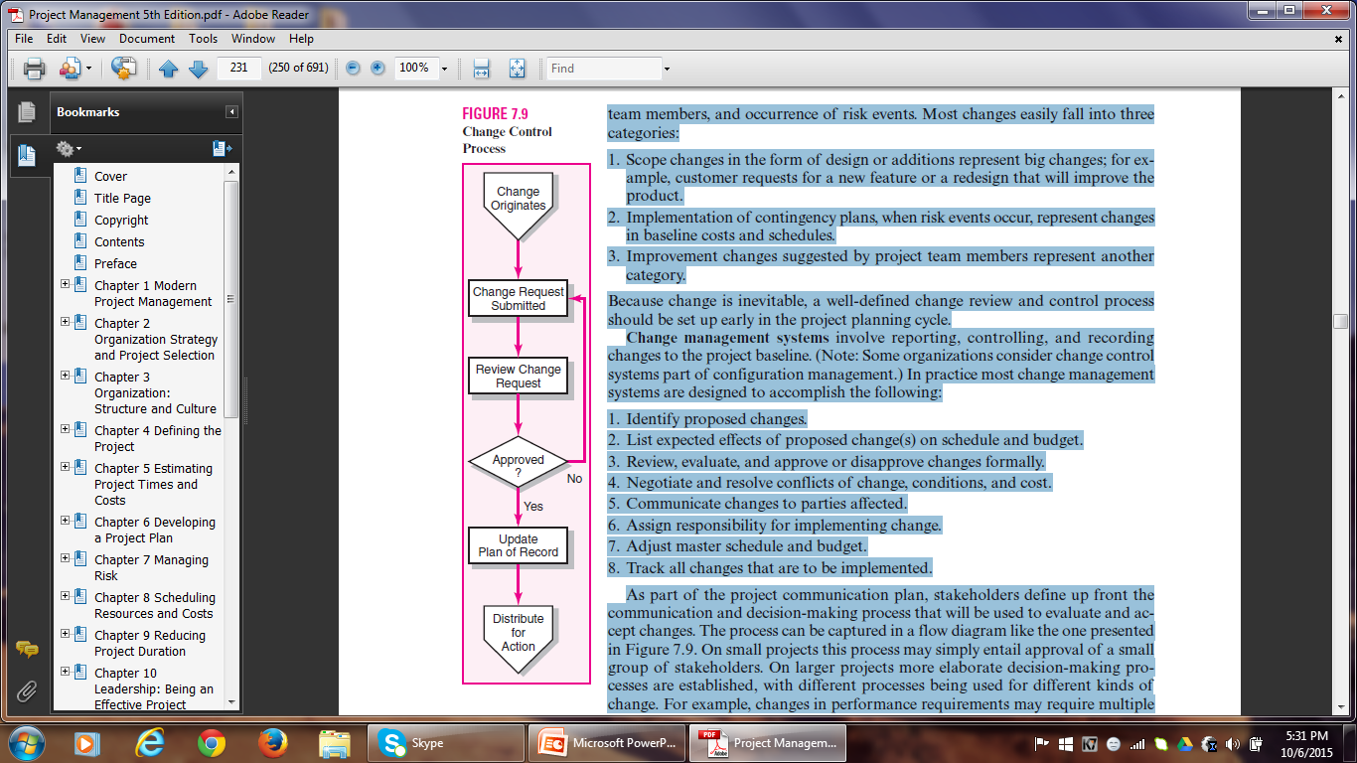
CHANGE CONTROL MANAGEMENT

Slide 67
CHANGE CONTROL MANAGEMENT
Change Request Forms and Logs are used to track proposed changes.
The benefits derived from change control systems are the following:
1. Inconsequential changes are discouraged by the formal process.
2. Costs of changes are maintained in a log.
3. Integrity of the WBS and performance measures is maintained.
4. Allocation and use of budget and management reserve funds are tracked.
5. Responsibility for implementation is clarified.
6. Effect of changes is visible to all parties involved.
7. Implementation of change is monitored.
8. Scope changes will be quickly reflected in baseline and performance measures.

Slide 68
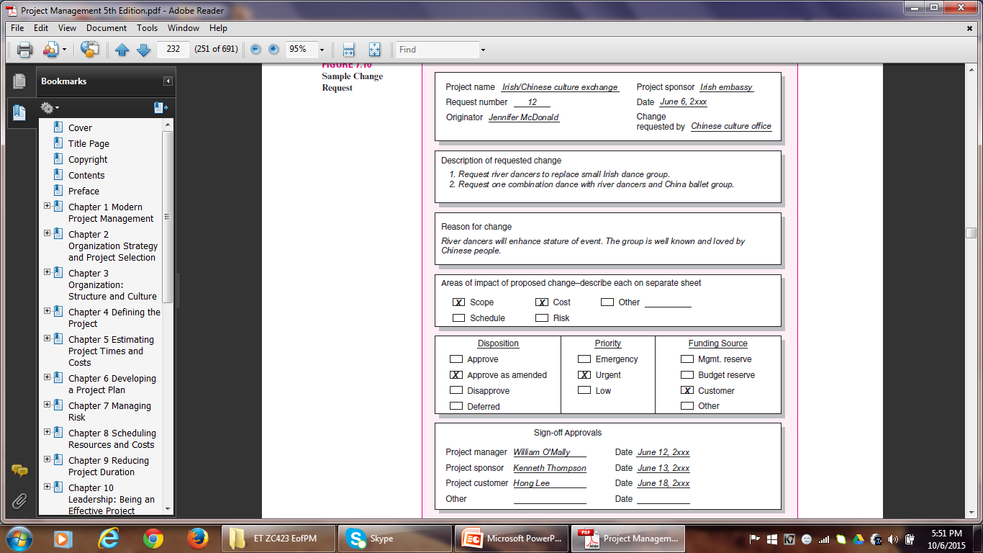
CHANGE REQUEST FORM

Slide 69
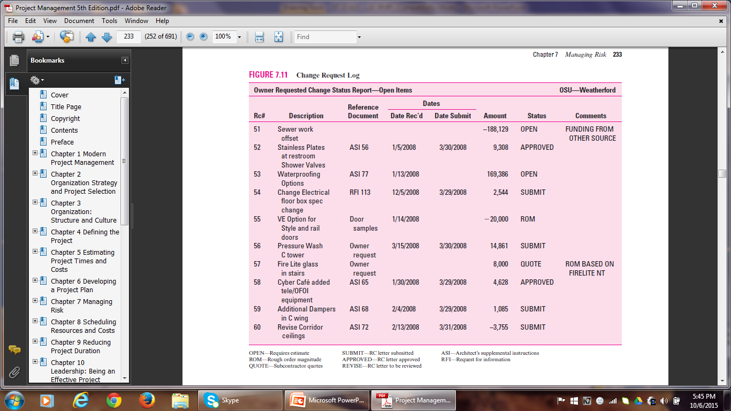
CHANGE REQUEST LOG

Slide 70
CASE 7.1
Alaska Fly-Fishing Expedition
Objective: The President of BlueNote, Inc. would like to reward her top management team by taking them on an all-expense-paid fly-fishing adventure in Alaska. Great Alaska Adventures (GAA) will be responsible for organizing and leading the expedition. The expedition will include a 5 day fly-fishing expedition down the Tikchik River system in Alaska from June 21 to 25. The cost of the expedition is not to exceed $35,000. Guests will be responsible for their own travel arrangements to and from Dillingham, Alaska and for their own fly-fishing equipment as well as clothing.

Slide 71
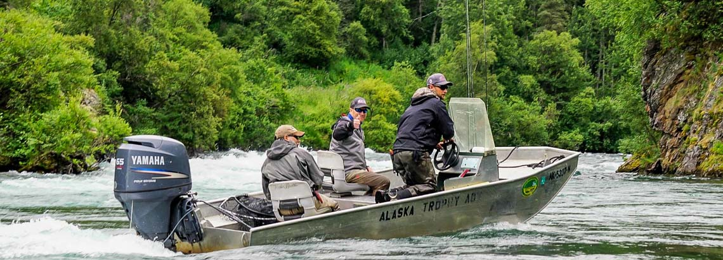
Alaska Fly-Fishing Expedition

Slide 72
Alaska Fly-Fishing Expedition
Deliverables: The deliverables for this project include the following: air transportation to and from Dillingham to and from camps I & II, river transportation that consists of 2 8-man drift boats with outboard motors, 3 meals a day for all attending guests, 4 hours of fly-fishing instruction, overnight accommodations at the Dillingham lodge in addition to 3 4-man tents with cots, bedding, and lanterns, 4 experienced river guides who are also experienced fly fisherman, fishing licenses for all guests, and digital cellular communication devices.

Slide 73
Alaska Fly-Fishing Expedition
Milestones: The milestones for this project have been broken down into four main parts.
These include:
The signing of the contract due by January 22
Guest arrival in Dillingham by June 20
Departure to Base Camp I on June 21, and
Departure to Dillingham on June 25 from Base Camp II.

Slide 74
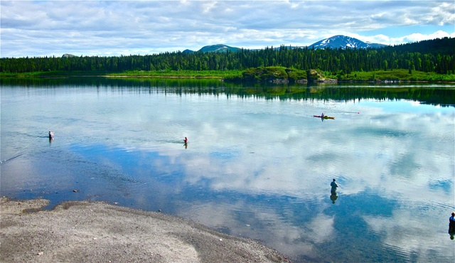
Alaska Fly-Fishing Expedition

Slide 75
Alaska Fly-Fishing Expedition
(WBS)
1.0 Alaska Fly-Fishing Expedition
1.1 Confirm number of guests attending
1.1.1 Apply and receive fishing licenses for all guests
1.2 Make overnight accommodations at Dillingham lodge for the night of
20^{the} and 25th June
1.2.1 Purchase 3 4-man tents with cots, bedding, lanterns
1.2.2 Make arrangements to feed all guests 3 times a day
1.3 Hire a pilot
1.3.1. Transport guests from Dillingham to Camp-I on 21st June
early morning
1.3.2. Transport guests from Camp-II to Dillingham on 25th June
evening
1.4 Hire river transportation
1.4.1 Hire 4 experienced river guides
1.4.2 Hire fly-fishing instructor
1.5 Obtain digital cellular communication devices

Slide 76
Alaska Fly-Fishing Expedition
Risks: There are several risks associated with this project. These may include –
Dillingham lodge unable to accommodate on specified date(s),
Lack of availability of pilot or airplane for transportation to and from Dillingham,
An instructor not available to provide 4 hours of fly-fishing instruction,
River guides unavailable for expedition,
Malfunction of cellular devices or lack of signal thereto,
Malfunction of motor boats.

Slide 77
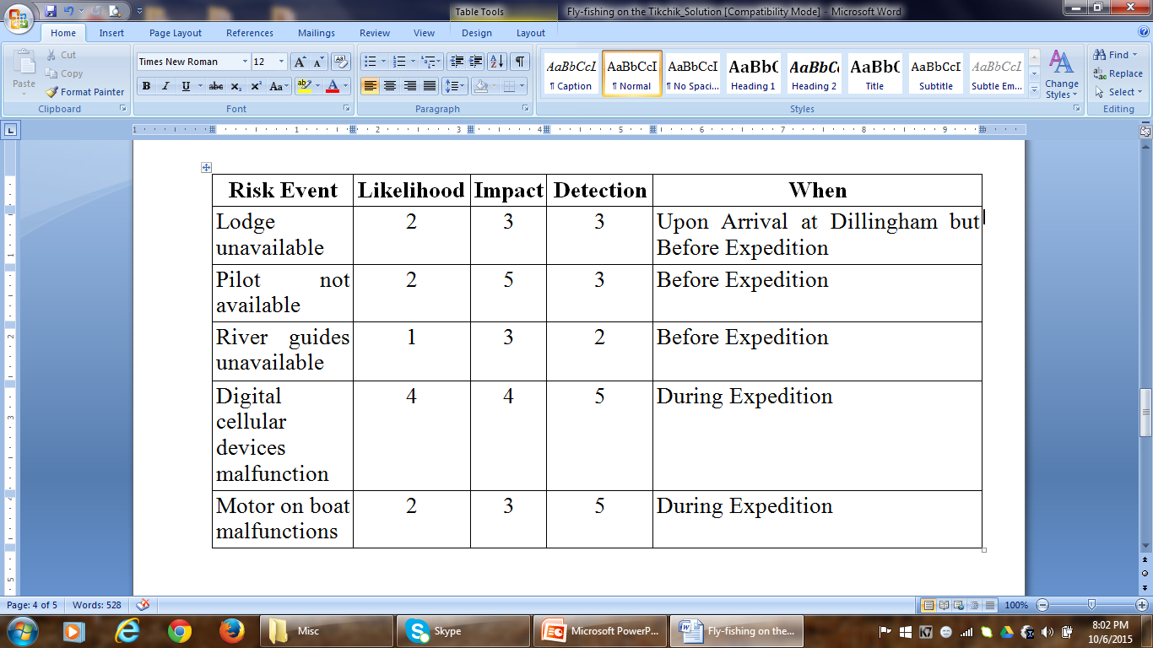
Risk Assessment Form

Slide 78
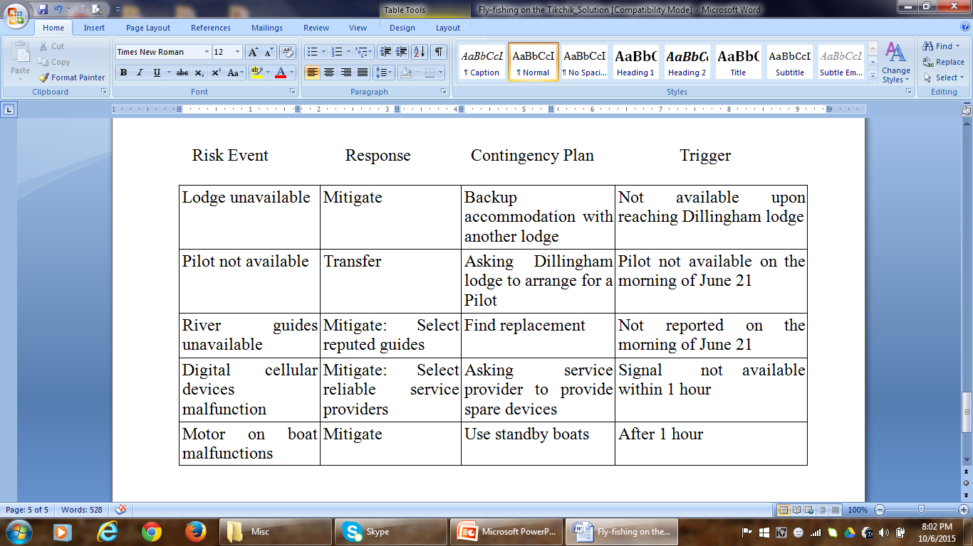
Risk Response Matrix

Slide 79

CASE 7.1 Revisited
Alaska Fly-Fishing Expedition

Slide 80
Alaska Fly-Fishing Expedition
After brainstorming, we identify the following as major risks associated with the project:
1. Disorientation (loss of direction) – this may happen due to navigation errors, navigation equipment malfunctioning or poor weather conditions.
2. Fuel shortage – due to inaccuracies in the estimate or some unanticipated occurrence.
3. Inclement weather – can lead to many problems like a boat capsizing, airplane not able to take off or land on time, tents getting uprooted…
4. Sickness or injury – during travel, fly-fishing, night stay in tents…
5. Bear Attacks – during fly-fishing, night stay in tents…

Slide 81
Alaska Fly-Fishing Expedition
Scale
1 = Very Low
2 = Low
3 = Medium
4 = High
5 = Very High

Slide 82
Alaska Fly-Fishing Expedition
Risk Assessment Matrix
Risk Event | Likelihood | Impact | Detection Difficulty | When
Loss of Direction | 2 | 5 | 5 | Boat Ride
Fuel Shortage | 1 | 4 | 1 | Boat Ride
Inclement Weather | 4 | 5 | 4 | Flight/ Boat Ride/ Night Stay
Sickness/ Injury | 3 | 3 | 1 | Entire Trip
Bear Attacks | 3 | 5 | 2 | Fly-Fishing/ Night Stay

Slide 83
Alaska Fly-Fishing Expedition
Detection – Likelihood – Impact
Loss of Direction
Detection of such an error is very difficult as people depend more on electronic navigation devices these days. If the device goes haywire/ malfunctions, it is very difficult to detect until the last moment.
Likelihood of happening is low since latest devices these days are very reliable and GAA has experienced river guides. But there can be data input errors and network problems with the navigation system which might give wrong directions. And guides may also find it difficult to find directions due to bad weather.
Impact will be very high as people on board are in great danger of getting lost which may delay or end the whole project.

Slide 84
Alaska Fly-Fishing Expedition
Detection – Likelihood – Impact
2. Fuel Shortage
This is easy to find as there is a meter to check the level of fuel in the boat.
GAA’s experience will come in handy in making correct estimates of the quantity of fuel required for the whole river trip which will reduce the probability of fuel shortage. Also, keeping extra cans of fuel will help.
Impact would be high as the travelers will be dissatisfied with the situation and the loss of time.

Slide 85
Alaska Fly-Fishing Expedition
Detection – Likelihood – Impact
3. Weather Conditions
With new technology, it is possible to predict weather conditions more accurately. But sudden changes in weather may occur.
Climate of Alaska is extremely cold and there can be snowstorms. Often, these may occur suddenly.
Travelers have a high risk of losing their lives, getting injured or falling sick which might affect the entire trip.

Slide 86
Alaska Fly-Fishing Expedition
Detection – Likelihood – Impact
4. Sickness/ Injury
Easy to detect.
May occur due to extreme cold and one being susceptible to injuries and sickness. Quite expected in a trip like this.
Even if one person falls sick/ is injured, it will affect the entire group’s mood. If it is serious, might adversely affect the trip as well.
5. Bear Attacks
Not difficult to detect.
Most bears tend to avoid people. But probability is always there as Alaska abounds in Brown/grizzly bear.
An attack could be life-threatening/paralyzing.

Slide 87
Risk Response Matrix
Risk Event | Response | Contingency Plan | Trigger | Who is Responsible
Loss of Direction | Mitigate | Get help from Office | Still lost after 01 hour | Tour Guide
Fuel Shortage | Mitigate | Refill Fuel | Fuel Indicator | Project Manager
Inclement Weather | Accept | Send for Immediate Help | Call from Management | Project Manager
Sickness/ Injury | Mitigate | Seek First Aid; Have Early Medical Check-ups | Worsening of the Condition | Traveler
Bear Attacks | Mitigate: Cook away from Tent | Call for help; Have Bonfires and Safety Tools | An Animal Attack | Tour Guide

Slide 88
Project Management
Thank You!

